Slide 1
Financial plan and supporting documents
Milan Gocić
University of Niš
First SC meeting/ 08 May 2019
This project has been funded with support from the European Commission. This publication reflects the views only of the author, and the Commission cannot be held responsible for any use which may be made of the information contained therein.

Slide 2
Budget info
The grant shall be of a maximum of EUR 931,289.00 and shall take the form of:
Staff costs: 365,279 EUR
Travel costs: 90,210 EUR
Costs of stay 183,150 EUR
Equipment costs: 254,000 EUR
Subcontracting: 38,650 EUR
Total project expenditures: 931,289 EUR
Strengthening of master curricula in water resources management
for the Western Balkans HEIs and stakeholders
www.swarm.ni.ac.rs

Slide 3
Installments from EACEA to the Project coordinator
first pre-financing payment of 50% of the maximum amount: upon entry into force of the Grant Agreement (16 November 2018 -> 465,644.50 EUR)
second pre-financing of 40% of the maximum amount if:
  at least 70% of the previous pre-financing installment is spent
  the statement of costs incurred and the request for payment is sent to EACEA
  the progress report on the implementation of the Action (Intermediate report) is sent to EACEA
balance of 10% max upon the approval of the Final Report (EACEA payment or recovery 60 days following the reception of the FR )
Strengthening of master curricula in water resources management
for the Western Balkans HEIs and stakeholders
www.swarm.ni.ac.rs

Slide 4
Institution | Money transferred
P2 BOKU | 10,219.00
P3 NMBU | 10,943.75
P4 AUTh | 8,308.25
P5 UACEG | 6,399.00
P6 UNIRIFCE | 6,494.00
P7 UL | 8,480.00
P8 UNS | 5,375.75
P9 UNSA | 40,096.00
P10 UNMO | 38,763.75
P11 UPKM | 11,124.80
P12 TCASU | 2,542.50
P13 UoM | 4,763.75
P14 PWMC VV | 1,900.25
155,410.80
Strengthening of master curricula in water resources management
for the Western Balkans HEIs and stakeholders
www.swarm.ni.ac.rs

Slide 5
Institution | Money spent
P1 UNI | 14,994.96
P2 BOKU
P3 NMBU
P4 AUTh
P5 UACEG
P6 UNIRIFCE | 2,095.00
P7 UL
P8 UNS | 840.00
P9 UNSA
P10 UNMO
P11 UPKM | 1,000.00
P12 TCASU
P13 UoM
P14 PWMC VV
1st prefinancing: 465,644.50
Total: 18,929.96
% used on 1st prefinancing: 4.07 %
Strengthening of master curricula in water resources management
for the Western Balkans HEIs and stakeholders
www.swarm.ni.ac.rs

Slide 6
Monthly Rates valid in 11-2018
Bulgaria – 1 EUR = 1.9558 BGN (Bulgarian lev)
Croatia – 1 EUR = 7.4315 HRK (Croatian kuna)
Norway – 1 EUR = 9.5435 NOK
Bosnia and Herzegovina – 1 EUR = 1.95583 BAM (Bosnia and Herzegovina convertible mark)
Republic of Serbia – 1 EUR = 118.52 RSD (Serbian Dinar)
The rates indicated are the market rates for the penultimate day of the previous month quoted by the European Central Bank or, depending on availability, provided by the delegations or other appropriate sources close to that date.
Strengthening of master curricula in water resources management
for the Western Balkans HEIs and stakeholders
www.swarm.ni.ac.rs

Slide 7
Financing approach
Actual costs: budget headings Equipment and Subcontracting
Unit Costs: budget headings Staff costs, Travel costs and Costs of stay
Strengthening of master curricula in water resources management
for the Western Balkans HEIs and stakeholders
www.swarm.ni.ac.rs

Slide 8
Actual costs
Expenses actually incurred
Need to be duly documented and justified with the corresponding level of cost incurred
Strengthening of master curricula in water resources management
for the Western Balkans HEIs and stakeholders
www.swarm.ni.ac.rs

Slide 9
Eligible costs (Art. II.19)
Incurred during the eligibility period
Foreseen in the application/budget
In connection with the action and necessary for project implementation
Identifiable, verifiable, recorded in accounting records of the beneficiary
Comply with requirements of applicable tax and national legislation
Reasonable, justified, complying with principle of sound financial management, in particular regarding economy and efficiency
Strengthening of master curricula in water resources management
for the Western Balkans HEIs and stakeholders
www.swarm.ni.ac.rs

Slide 10
Ineligible costs (Art. I.10.4/II.19.4)
equipment such as: furniture, motor vehicles of any kind, equipment for research and development purposes, telephones, mobile phones, alarm systems and anti-theft systems;
costs of premises (purchase, rent, heating, maintenance, repairs etc.); please note that the rent of premises for short events is not concerned;
costs linked to the purchase of real estate;
expenses for activities that are not carried out in the project beneficiaries' country (see Annex IV of the Agreement), unless an explicit prior written authorisation has been granted by the Agency;
depreciation costs;
return on capital;
Strengthening of master curricula in water resources management
for the Western Balkans HEIs and stakeholders
www.swarm.ni.ac.rs

Slide 11
Ineligible costs (Art. I.10.4/II.19.4)
debt and debt service charges;
provisions for losses or debts;
interest owed;
doubtful debts;
exchange losses;
costs of transfers from the Agency charged by the bank of a beneficiary;
costs declared by a beneficiary in the framework of another action receiving a grant financed from the Union budget;
contributions in kind from third parties;
excessive or reckless expenditure;
taxes (VAT, duties and charges)
Strengthening of master curricula in water resources management
for the Western Balkans HEIs and stakeholders
www.swarm.ni.ac.rs

Slide 12
Tendering procedure
The beneficiary shall apply the tendering procedure for the purchase of any kind of goods or services whenever the amount of the purchase/sub-contract is between EUR 25.000 and 134.000
Principles of transparency, equal treatment of potential contractors, avoiding conflicts of interests
Criterion for selection of offer: best value for money
If value of purchase/sub-contract > EUR 134.000:
national legislation applicable
Split purchase/sub-contract into smaller contracts below the threshold to avoid a tendering procedure -> NO
Strengthening of master curricula in water resources management
for the Western Balkans HEIs and stakeholders
www.swarm.ni.ac.rs

Slide 13
Equipment
Relevant to the objectives of the project foreseen in the application
Examples: (e-)books and periodicals, fax machines, photocopying machines, computers, software, machines and equipment for teaching purposes etc
Total purchase cost (not depreciation)
Exclusively for Partner Country HEIs
Purchased and installed at the beginning of the project
Recorded in inventory of institution where it is installed
Labelled with E+ stickers
Not foreseen in the application/budget? -> Prior written authorisation from Agency
Strengthening of master curricula in water resources management
for the Western Balkans HEIs and stakeholders
www.swarm.ni.ac.rs

Slide 14
Equipment – Supporting documents
Invoice(s) for all purchased equipment (please note that order forms, pro-forma invoices, quotations or estimates are not considered as proof of expenditure). Certified copy
VAT exemption statement Certified copy
Documentation on the tendering procedure and three quotations (for more than 25000 Euros) Certified copy
Proof of payment (bank statement) Certified copy
Proof that equipment is recorded in inventory of the institution + analytical cards Certified copy
Contract with chosen supplier Certified copy
Photos
Any prior authorisation from the Agency
Strengthening of master curricula in water resources management
for the Western Balkans HEIs and stakeholders
www.swarm.ni.ac.rs

Slide 15
Subcontracting
Implementation of specific tasks, by third party, to which a contract is awarded by one/several beneficiaries
Examples (provided that it cannot be carried out by beneficiaries' staff):
  Evaluation activities/auditing (Audit Certificate on Financial Statement)
  IT courses, Language courses
  Printing, publishing and dissemination activities
  Translation services
  Web design and maintenance
  Logistic support for the organisation of events
Not foreseen in the application/budget? -> Prior written authorisation from Agency
Strengthening of master curricula in water resources management
for the Western Balkans HEIs and stakeholders
www.swarm.ni.ac.rs

Slide 16
Subcontracting – Supporting documents
Invoices, subcontracts and proof of payment (bank statement) Certified copy
> EUR 25.000 < EUR 134.000: tendering procedure and three quotations from different suppliers
Tangible outputs/products (2 pieces)
Any prior authorisation from the Agency
Photos
Strengthening of master curricula in water resources management
for the Western Balkans HEIs and stakeholders
www.swarm.ni.ac.rs

Slide 17
Actual costs
Fixed contribution (not fractioned) multiplied by number of units
"Triggering event" -> activities implemented/outputs produced during the eligibility period (tangible outputs)
No need to justify level/amount of costs incurred
In case of financial control/audit declared unit costs supported with proof demonstrating that activities implemented
If activity/output not accepted (e.g. not supported by concrete evidences) -> no corresponding unit costs is granted
Strengthening of master curricula in water resources management
for the Western Balkans HEIs and stakeholders
www.swarm.ni.ac.rs

Slide 18
Staff Costs (max. 40% of total budget)
Performing tasks necessary to achievement of the project
Formal contractual relationship
Calculation of the grant: staff category, country in which staff member is employed, number of days worked
Each unit cost corresponds to an amount in Euro per working day per staff
Categories: Managers/Researchers, Teachers and trainers/Technical staff /Administrative staff
Staff category: nature of work performed, not status of individual
Unit cost: country in which staff is employed, independently of where tasks are executed
Strengthening of master curricula in water resources management
for the Western Balkans HEIs and stakeholders
www.swarm.ni.ac.rs

Slide 19
Staff categories
Manager (legislators, senior officials and managers)
Teacher/Trainer, Researcher (typically carry out academic activities related to curriculum/training programme development, development and adaptation of teaching/training materials, preparation and teaching of courses or trainings)
Techican (technicians and associate professionals)
Adminastrative (office and customer service clerks)
Strengthening of master curricula in water resources management
for the Western Balkans HEIs and stakeholders
www.swarm.ni.ac.rs

Slide 20
Staff costs calculation
Example: a staff employed in WB country performing teaching activity for 3 days -> 240 Euro (3 unit costs of 80 Euro each)
Calculation of the grant:
  based on application of unit costs and independent from actual remuneration (defined in the Partnership Agreement)
  obtained by multiplying unit cost (corresponding to category of country and staff) by number of working days spent on the project per staff member
Strengthening of master curricula in water resources management
for the Western Balkans HEIs and stakeholders
www.swarm.ni.ac.rs

Slide 21
Staff costs calculation
One working day defined according to applicable national legislation
Declared working days per individual should not exceed 20 days per month or 240 days per year
Strengthening of master curricula in water resources management
for the Western Balkans HEIs and stakeholders
www.swarm.ni.ac.rs

Slide 22
Staff costs – Supporting documents
JOINT DECLARATION (Annex II) for each person employed ORIGINAL
TIME-SHEETS (attached to each staff convention), indicating number of days worked for corresponding month/year, description of tasks , outputs produced and related work package ORIGINAL
FORMAL CONTRACTUAL RELATIONSHIP (EMPLOYMENT CONTRACT) Certified copy
ANY EVIDENCE allowing to verify that declared workloads correspond to actual activities/outputs (e.g. attendance lists for lectures given, tangible outputs / products, salary slips, etc.) Certified copy
Strengthening of master curricula in water resources management
for the Western Balkans HEIs and stakeholders
www.swarm.ni.ac.rs

Slide 23
Staff costs – Supporting documents
PROOF OF PAYMENT (net + taxes) Certified copy
Calculation of gross, net and tax amount (especially important when for paying is used other currency than euro) Certified copy
Contract for working on SWARM project Certified copy
Strengthening of master curricula in water resources management
for the Western Balkans HEIs and stakeholders
www.swarm.ni.ac.rs

Slide 24
Rules for designation of Joint declaration
EXAMPLE 1:
If there are documents regarding to Staff Costs, we use next approach for coding Joint Declaration document (Annex II).
P1 is the first partner institution. In our case, the University of Nis.
P1 – JD – 001
P1 – partner number
JD – Joint Declaration (Staff Costs -Budget Headings)
001÷100 Three digits should be used
Strengthening of master curricula in water resources management
for the Western Balkans HEIs and stakeholders
www.swarm.ni.ac.rs

Slide 25
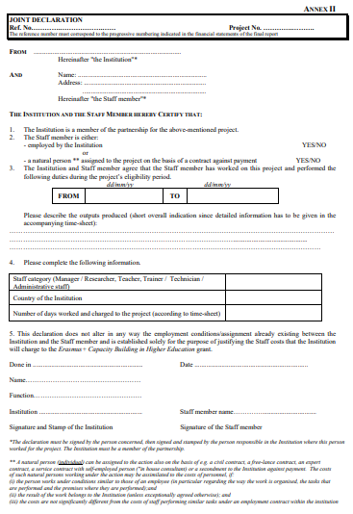
Rules for designation of Joint declaration
P1 – JD – 001
597888-EPP-1-2018-1-RS-EPPKA2-CBHE-JP
All documents to be delivered in hard copies
All these documents which regarding the Staff costs, Travel costs etc, should be scanned and posted on the project platform in the area that provided for this purpose. http://mngt.swarm.ni.ac.rs/
Strengthening of master curricula in water resources management
for the Western Balkans HEIs and stakeholders
www.swarm.ni.ac.rs

Slide 26
Joint declaration
Joint declaration must be in line with time-sheet (number of days and description of tasks performed and outputs produced)
Staff costs filled in Financial report must be in line with both joint declaration and time-sheet
One person can be engaged regarding different staff categories (for example, manager and researcher/teacher/trainer)
Joint declaration and time-sheet must be signed by legal representative
Time-sheet should be attached to each joint declaration
Declared working days should not exceed 20 days per month or 240 days per year
Strengthening of master curricula in water resources management
for the Western Balkans HEIs and stakeholders
www.swarm.ni.ac.rs

Slide 27
Joint declaration
be careful about the reference number
insert YES/NO fields regarding employment contract
provide employment contract
provide documents for the financial transaction
project’s eligibility period should be in line with the financial plan and work plan
insert the staff category in line with the time-sheet
the staff category to be applied does not depend on the status or title of the individual
for staff performing different categories of tasks a separate convention must be signed for each type of activity
the person performing the activity and legal representative must sign joint declaration and stamped
Strengthening of master curricula in water resources management
for the Western Balkans HEIs and stakeholders
www.swarm.ni.ac.rs

Slide 28
Time-sheet
the staff category should be in line with the joint declaration
describe the tasks performed
describe the output produced (obligatory)
the related work package and the described task must be in line with the work plan (WP1– Preparation, WP2, WP3, WP4 – Development, WP5 – Quality, WP6 – Dissemination/Exploitation, WP7 – Management)
the number of days must be in line with the defined HEI financial plan
be careful about year and month
the person concerned and legal representative must sign time-sheet
Strengthening of master curricula in water resources management
for the Western Balkans HEIs and stakeholders
www.swarm.ni.ac.rs

Slide 29
Joint declaration and Time-sheet
Work Package + Activity + Description of tasks performed + Tangible outputs produced (report, event organization, plan, guideline, leaflet, book material, training material, etc.)
Example:
WP1 Analysis of water resources management in the Western Balkan region: A1.2 Analyse of EU innovations in water policy and EU recommendations and legislation in water sector - Writing the UNIRIFCE part of the report - Report created
Strengthening of master curricula in water resources management
for the Western Balkans HEIs and stakeholders
www.swarm.ni.ac.rs

Slide 30
Travel costs and Costs of stay
Staff/students participating in activities related to the achievement of the project
Unit costs to apply: travel distance (for travel costs), duration for costs of stay and type of participant
Prior authorisation for activities not taking place in countries represented in the partnership
Prior authorisation for activities not described in the Guidelines (section 3.3.1.2)
Strengthening of master curricula in water resources management
for the Western Balkans HEIs and stakeholders
www.swarm.ni.ac.rs

Slide 31
Travel costs and Costs of stay
Staff
  Under contract with beneficiary institutions and involved in the project
  Travels intended for the activities listed in the Guidelines
  Duration: Max. 3 months
Students
  Registered in one of the beneficiary institutions
  Targeted mainly at Partner Country students and intended for activities listed in the Guidelines (overview table)
  Duration: Min. 2 weeks – Max. 3 months (Max. 1 week for short term activities linked to the management of the project)
Strengthening of master curricula in water resources management
for the Western Balkans HEIs and stakeholders
www.swarm.ni.ac.rs

Slide 32
Travel costs and Costs of stay – Supporting documents
Justification for the following elements:
  Journeys actually took place
  Journeys connected to specific and identifiable project-related activities
To be retained with project accounts:
INDIVIDUAL TRAVEL REPORT (ITR) Original
Supporting documents (e.g. travel tickets, boarding passes, invoices, receipts, proof of attendance in meetings and/or events, agendas, tangible outputs/products, minutes of meetings) Certified copy
Proof of payment for travel costs and costs of stay (bank statement) Certified copy
Proof of payment for taxes (if any) Certified copy
Any prior authorisation from the Agency
Strengthening of master curricula in water resources management
for the Western Balkans HEIs and stakeholders
www.swarm.ni.ac.rs

Slide 33
Travel costs and Costs of stay – Supporting documents
Invoices for accommodation Certified copy
Calculation of gross, net and tax amount (especially important when for paying is used other currency than euro) Certified copy
Strengthening of master curricula in water resources management
for the Western Balkans HEIs and stakeholders
www.swarm.ni.ac.rs

Slide 34
Rules for designation of ITR
EXAMPLE 1:
We use next approach for coding Individual Travel Report document (Annex III).
P1 is the first partner institution. In our case, the University of Nis.
P1 – ITR – 001
P1 – partner number
ITR – Individual Travel Report (Travel Costs and Costs of Stay -Budget Headings)
001÷100 Three digits should be used
Strengthening of master curricula in water resources management
for the Western Balkans HEIs and stakeholders
www.swarm.ni.ac.rs

Slide 35
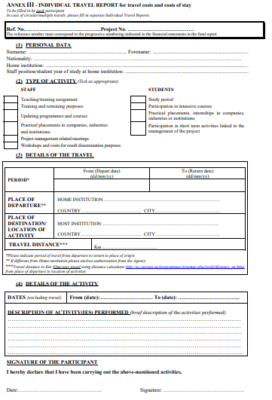
Rules for designation of ITR
P1 – JITR– 001
597888-EPP-1-2018-1-RS-EPPKA2-CBHE-JP
All documents to be delivered in hard copies
Strengthening of master curricula in water resources management
for the Western Balkans HEIs and stakeholders
www.swarm.ni.ac.rs

Slide 36
Travel costs and Costs of stay – Example
Travel: Nis (RS) – Vienna (AT), 4 days
Distance: 691.59 km => 275 Eur
Distance calculator
http://ec.europa.eu/programmes/erasmus-plus/tools/distance_en.htm
Stay costs: 4 days => 480 Eur
TOTAL: 275 + 480 = 755 EUR
Strengthening of master curricula in water resources management
for the Western Balkans HEIs and stakeholders
www.swarm.ni.ac.rs

Slide 37
Travel costs and Costs of stay
Travel costs
Costs of stay (120EUR per day)
Distance | Eligible cost
10 – 99 km | 20 Eur
100 – 499 km | 180 Eur
500 – 1999 km | 275 Eur
2000 – 2999 km | 360 Eur
3000 – 3999 km | 530 Eur
4000 – 7999 km | 820 Eur
8000 km and more | 1100 Eur
No. of days | Eligible cost
1 | 120
2 | 240
3 | 360
4 | 480
5 | 600
6 | 720
Strengthening of master curricula in water resources management
for the Western Balkans HEIs and stakeholders
www.swarm.ni.ac.rs

Slide 38
Individual Travel Report (ITR)
purpose: for specification of travel costs and costs of stay
to be filled in by each participant
in case of multiple travels, fill in separate ITR
type of activity should be in line with the work plan
details of the travel:
  indicate period of travel from departure to return to place of origin
  place of departure: If different from Home institution please enclose authorisation from the Agency
  travel distance in km – one way travel (distance calculator: http://ec.europa.eu/programmes/erasmus-plus/tools/distance_en.htm)
Strengthening of master curricula in water resources management
for the Western Balkans HEIs and stakeholders
www.swarm.ni.ac.rs

Slide 39
Individual Travel Report (ITR)
details of activity:
  dates excluding travel
  brief description of the activity performed should be inserted
provide documents regarding financial transactions
invoces, receipts, boarding passes
add agenda and participation list for all days
only participant should sign ITR
Strengthening of master curricula in water resources management
for the Western Balkans HEIs and stakeholders
www.swarm.ni.ac.rs

Slide 40
Checks and Audits (Art. II.27)
The EACEA and/or the Commission may carry out technical and financial checks and audits in relation to the use of the grant
Carried out either directly by EACEA / Commission or by an outside body authorised to do so on its behalf
During the implementation of the Agreement and for a period of five years starting from the date of payment of the balance
Contractual obligation of the project to carry out a financial audit at final report stage
Strengthening of master curricula in water resources management
for the Western Balkans HEIs and stakeholders
www.swarm.ni.ac.rs

Slide 41
Documentation
All financial documentation should be prepared in two hard copies for UNI + one or more copies for your HEI and sent by post at
For SWARM
Milan Gocic
University of Nis
Univerzitetski trg 2
18000 Nis
SERBIA
Financial documentation (staff costs, travel costs, equipment and subcontracting costs) should be scanned as pdf and uploaded on SWARM platform under your HEI acronym or sent at swarmuni@gmail.com.
Strengthening of master curricula in water resources management
for the Western Balkans HEIs and stakeholders
www.swarm.ni.ac.rs

Slide 42
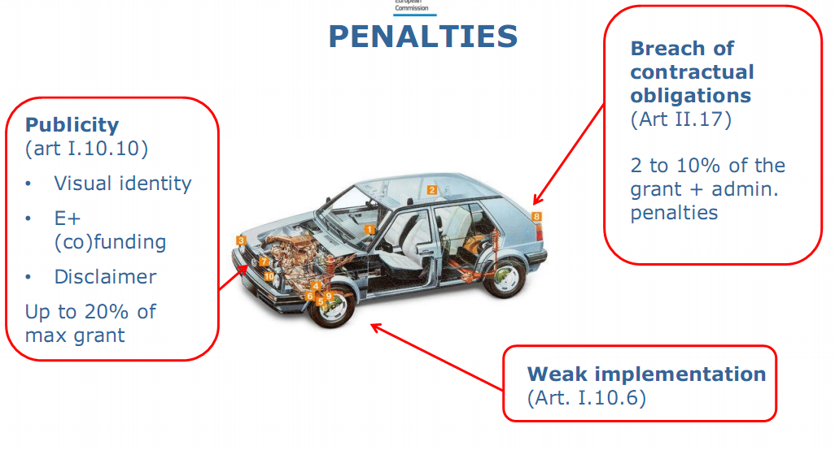
Strengthening of master curricula in water resources management
for the Western Balkans HEIs and stakeholders
www.swarm.ni.ac.rs

Slide 43
Penalties
Grant Agreement defining the penalties for poor, partial or late implementation of project activities (Article I.10.6, II.17) and visibility obligations (Articles I.10.9 and I.10.10) with the purpose of sound financial management and to avoid any possible risks.
Strengthening of master curricula in water resources management
for the Western Balkans HEIs and stakeholders
www.swarm.ni.ac.rs

Slide 44
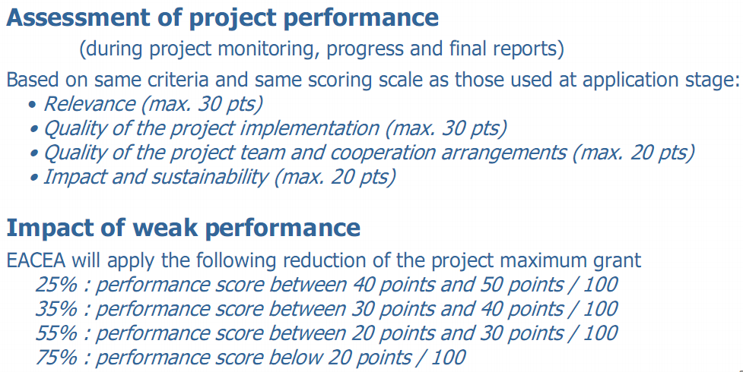
Penalties for weak implementation
Strengthening of master curricula in water resources management
for the Western Balkans HEIs and stakeholders
www.swarm.ni.ac.rs

Slide 45
Article I.10.10 Penalties in the case of non-compliance with publicity obligations
The obligation to comply with the publicity provisions set out in Article II.7 of the General Conditions constitutes a substantial obligation. Without prejudice to the right to terminate the grant, in case of failure to fulfil this obligation, the Agency may apply a 20% reduction of the grant initially provided for.
Strengthening of master curricula in water resources management
for the Western Balkans HEIs and stakeholders
www.swarm.ni.ac.rs

Slide 46
Article I.10.10 Administrative and financial penalties
Beneficiary which has committed substantial errors, irregularities or fraud, has made false declarations in supplying required information or has failed to supply such information at the moment of the submission of the application or during the implementation of the grant,or has been found in serious breach of its obligations under the Agreement shall be liable to:
a) administrative penalties consisting of exclusion from all contracts and grants financed by Union budget for a maximum of five years from the date on which the infringement is established and confirmed following a contradictory procedure with the beneficiary
Strengthening of master curricula in water resources management
for the Western Balkans HEIs and stakeholders
www.swarm.ni.ac.rs

Slide 47
Article I.10.10 Administrative and financial penalties
b) financial penalties of 2% to 10% of the value of the contribution the beneficiary concerned is entitled to in accordance with the estimated budget set out in Annex III.
In the event of another infringement within five years following the establishment of the first infringement, the period of exclusion under point a) may be extended to 10 years and the range of the rate reffered to in point b) may be increased to 4% to 20%.
Strengthening of master curricula in water resources management
for the Western Balkans HEIs and stakeholders
www.swarm.ni.ac.rs

Slide 48
  Be careful
  Check twice before signing
Strengthening of master curricula in water resources management
for the Western Balkans HEIs and stakeholders
www.swarm.ni.ac.rs

